Slide 1
Transport-Level Security
Notes:
Opening quote.

Slide 2
Web Security
Web now widely used by business, government, individuals
but Internet & Web are vulnerable
have a variety of threats
  integrity
  confidentiality
  denial of service
  authentication
need added security mechanisms
Notes:
The World Wide Web is widely used by businesses, government agencies, and many individuals. But the Internet and the Web are extremely vulnerable to compromises of various sorts, with a range of threats as shown briefly above, and in detail in Stallings Table 5.1. These can be described as passive attacks including eavesdropping on network traffic between browser and server and gaining access to information on a Web site that is supposed to be restricted; and active attacks including impersonating another user, altering messages in transit between client and server, and altering information on a Web site. The web needs added security mechanisms to address these threats.

Slide 3
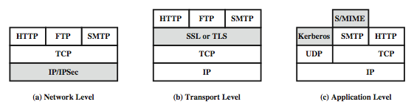
Web Traffic Security Approaches
Notes:
A number of approaches to providing Web security are possible. The various approaches that have been considered are similar in the services they provide and, to some extent, in the mechanisms that they use, but they differ with respect to their scope of applicability and their relative location within the TCP/IP protocol stack. Stallings Figure 16.1 illustrates this difference.
One way to provide Web security is to use IP Security (Figure 16.1a). The advantage of using IPSec is that it is transparent to end users and applications and provides a general-purpose solution. Further, IPSec includes a filtering capability so only selected traffic need incur the IPSec processing overhead.
Another relatively general-purpose solution is to implement security just above TCP (Figure 16.1b). The foremost example of this approach is the Secure Sockets Layer (SSL) and the follow-on Internet standard known as Transport Layer Security (TLS). At this level, there are two implementation choices. For full generality, SSL (or TLS) could be provided as part of the underlying protocol suite and therefore be transparent to applications. Alternatively, SSL can be embedded in specific packages, e.g. both the Netscape and Microsoft Explorer browsers come with SSL, & most Web servers have implemented it.
Application-specific security services are embedded within the particular application. Figure 16.1c shows examples of this architecture. The advantage of this approach is that the service can be tailored to the specific needs of a given application.

Slide 4
SSL (Secure Socket Layer)
Transport layer security service
originally developed by Netscape
version 3 designed with public input
subsequently became Internet standard known as TLS (Transport Layer Security)
uses TCP to provide a reliable end-to-end service
SSL has two layers of protocols
Notes:
SSL probably most widely used Web security mechanism, and it is implemented at the Transport layer (cf. figure 16.1b on previous slide).
SSL is designed to make use of TCP to provide a reliable end-to-end secure service. Netscape originated SSL. Version 3 of the protocol was designed with public review and input from industry and was published as an Internet draft document. Subsequently, when a consensus was reached to submit the protocol for Internet standardization, the TLS working group was formed within IETF to develop a common standard. This first published version of TLS can be viewed as essentially an SSLv3.1 and is very close to and backward compatible with SSLv3. SSL is not a single protocol but rather two layers of protocol, as shown next.

Slide 5
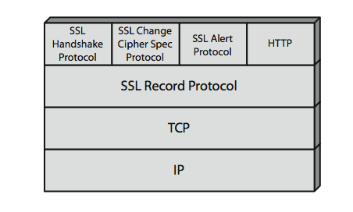
SSL Architecture
Notes:
Stallings Figure 5.2 shows the SSL Protocol stack.
The SSL Record Protocol provides basic security services to various higher-layer protocols. In particular, the Hypertext Transfer Protocol (HTTP), which provides the transfer service for Web client/server interaction, can operate on top of SSL.
Three higher-layer protocols are also defined as part of SSL: the Handshake Protocol, Change Cipher Spec Protocol, and Alert Protocol. These SSL-specific protocols are used in the management of SSL exchanges.

Slide 6
SSL Architecture
SSL connection
  a transient, peer-to-peer, communications link
  associated with 1 SSL session
SSL session
  an association between client & server
  created by the Handshake Protocol
  define a set of cryptographic parameters
  may be shared by multiple SSL connections
Notes:
Two important SSL concepts are the SSL connection and the SSL session:
• Connection: A connection is a network transport that provides a suitable type of service, such connections are transient, peer-to-peer relationships, associated with one session
• Session: An SSL session is an association between a client and a server, created by the Handshake Protocol. Sessions define a set of cryptographic security parameters, which can be shared among multiple connections. Sessions are used to avoid the expensive negotiation of new security parameters for each connection.
Between any pair of parties (applications such as HTTP on client and server), there may be multiple secure connections. In theory, there may also be multiple simultaneous sessions between parties, but this feature is not used in practice.
There are a number of states associated with each session. Once a session is established, there is a current operating state for both read and write (i.e., receive and send). In addition, during the Handshake Protocol, pending read and write states are created. Upon successful conclusion of the Handshake Protocol, the pending states become the current states. A session state and a connection state are defined by sets of parameters, see text for details.

Slide 7
SSL Record Protocol Services
confidentiality
  using symmetric encryption with a shared secret key defined by Handshake Protocol
  AES, IDEA, RC2-40, DES-40, DES, 3DES, Fortezza, RC4-40, RC4-128
  message is compressed before encryption
message integrity
  using a MAC with shared secret key
  similar to HMAC but with different padding
Notes:
SSL Record Protocol defines two services for SSL connections:
• Confidentiality: The Handshake Protocol defines a shared secret key that is used for conventional encryption of SSL payloads. The message is compressed before being concatenated with the MAC and encrypted, with a range of ciphers being supported as shown.
• Message Integrity: The Handshake Protocol also defines a shared secret key that is used to form a message authentication code (MAC), which is similar to HMAC

Slide 8
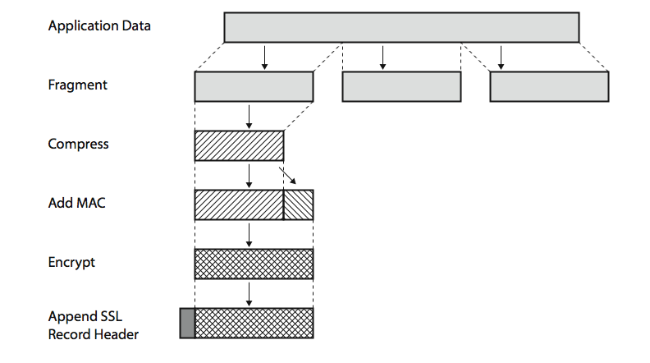
SSL Record Protocol Operation
Notes:
Stallings Figure 5.3 shows the overall operation of the SSL Record Protocol. The Record Protocol takes an application message to be transmitted, fragments the data into manageable blocks, optionally compresses the data, computes and appends a MAC (using a hash very similar to HMAC), encrypts (using one of the symmetric algorithms listed on the previous slide), adds a header (with details of the SSL content type, major/minor version, and compressed length), and transmits the resulting unit in a TCP segment. Received data are decrypted, verified, decompressed, and reassembled and then delivered to higher-layer applications. See text for additional details.

Slide 9
MAC Computation
MAC needs a shared secret key
Computation
Hash(MAC_write_secret|| pad_2 || hash(MAC_write_secret ||pad_1||seq_num ||SSLCompressed.type ||SSLCompressed.length ||SSLCompressed.fragment))

Slide 10
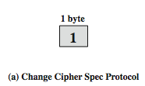
SSL Change Cipher Spec Protocol
one of 3 SSL specific protocols which use the SSL Record protocol
a single message
causes pending state to become current
hence updating the cipher suite in use
Notes:
The Change Cipher Spec Protocol is one of the three SSL-specific protocols that use the SSL Record Protocol, and it is the simplest, consisting of a single message (shown in Stallings Figure 16.5a), which consists of a single byte with the value 1. The sole purpose of this message is to cause the pending state to be copied into the current state, which updates the cipher suite to be used on this connection.

Slide 11

SSL Alert Protocol
conveys SSL-related alerts to peer entity
severity
    warning or fatal
specific alert
    fatal: unexpected message, bad record mac, decompression failure, handshake failure, illegal parameter
    warning: close notify, no certificate, bad certificate, unsupported certificate, certificate revoked, certificate expired, certificate unknown
compressed & encrypted like all SSL data
Notes:
The Alert Protocol is used to convey SSL-related alerts to the peer entity. As with other applications that use SSL, alert messages are compressed and encrypted, as specified by the current state.
Each message in this protocol consists of two bytes (as shown in Stallings Figure 16.5b), the first takes the value warning(1) or fatal(2) to convey the severity of the message. The second byte contains a code that indicates the specific alert. The first group shown are the fatal alerts, the others are warnings.

Slide 12

SSL Handshake Protocol
allows server & client to:
  authenticate each other
  to negotiate encryption & MAC algorithms
  to negotiate cryptographic keys to be used
comprises a series of messages in phases
  Establish Security Capabilities
  Server Authentication and Key Exchange
  Client Authentication and Key Exchange
  Finish
Notes:
The most complex part of SSL is the Handshake Protocol. This protocol allows the server and client to authenticate each other and to negotiate an encryption and MAC algorithm and cryptographic keys to be used to protect data sent in an SSL record. The Handshake Protocol is used before any application data is transmitted. The Handshake Protocol consists of a series of messages exchanged by client and server, which have the format shown in Stallings Figure 16.5c, and which can be viewed in 4 phases:
Phase 1. Establish Security Capabilities - this phase is used by the client to initiate a logical connection and to establish the security capabilities that will be associated with it
Phase 2. Server Authentication and Key Exchange - the server begins this phase by sending its certificate if it needs to be authenticated.
Phase 3. Client Authentication and Key Exchange - the client should verify that the server provided a valid certificate if required and check that the server_hello parameters are acceptable
Phase 4. Finish - this phase completes the setting up of a secure connection. The client sends a change_cipher_spec message and copies the pending CipherSpec into the current CipherSpec. At this point the handshake is complete and the client and server may begin to exchange application layer data.

Slide 13
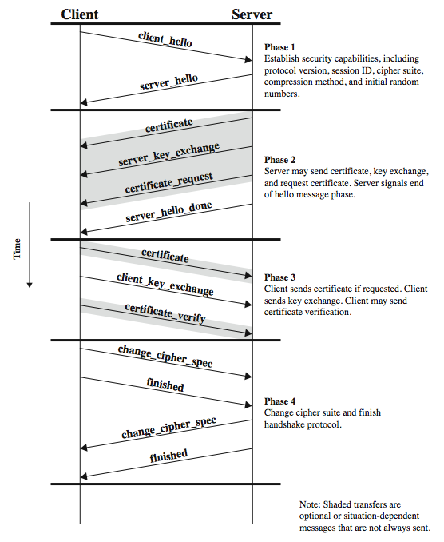
SSL Handshake Protocol
Notes:
Stallings Figure 5.6 shows the initial exchange needed to establish a logical connection between client and server. The exchange can be viewed as having the four phases discussed previously. Additional details on the operation of these phases is given in the text.

Slide 14
Client Hello Message
Version
Random
  32-bit timestamp and 28 bytes by a secure random number generator
Session ID
  Zero indicates a new connection on a new session
CipherSuite
  A key exchange algorithm and a CipherSpec
  The list is ordered in decreasing order of preference
Compression Method

Slide 15
Server Hello Message
Version
  Lower of version suggested by client and highest supported by server
Random
  32-bit timestamp and 28 bytes by a secure random number generator
Session ID
  Nonzero by client: same used by server
  Zero: value for a new session
CipherSuite
  Single cipher suite selected by server from sent by client
Compression Method
  Compression method selected by server

Slide 16
Key Exchange Methods
RSA
  Secret key encrypted with receiver’s RSA public key
Fixed Diffie-Hellman
  Public key certificate contains Diffie-Hellman public key parameters signed by certificate authority (CA)
  Fixed secret key between two peers
Ephemeral Diffie-Hellman
  Diffie-Hellman public keys are exchanged, signed using sender’s private RSA or DSS key
  Certificates used to authenticate public keys
  Temporary authenticated secret key
Anonymous Diffie-Hellman
Fortezza

Slide 17
CipherSpec
Cipher Algorithm
MAC Algorithm (MD5 or SHA1)
Cipher Type (Stream or Block)
IsExportable
Hash Size (0,16 (MD5), 20 (SHA-1) bytes)
Key Material (used in generating write keys)
IV Size (for CBC mode)

Slide 18
Cryptographic Computations
master secret creation
  a one-time 48-byte value
  generated using secure key exchange (RSA / Diffie-Hellman) and then hashing info
generation of cryptographic parameters
  client write MAC secret, a server write MAC secret, a client write key, a server write key, a client write IV, and a server write IV
  generated by hashing master secret
Notes:
Two further items are of interest: the creation of a shared master secret by means of the key exchange, and the generation of cryptographic parameters from the master secret.
The shared master secret is a one-time 48-byte value (384 bits) generated for this session by means of secure key exchange. The creation is in two stages. First, a pre_master_secret is exchanged. Second, the master_secret is calculated by both parties. For pre_master_secret exchange, there are two possibilities, using either RSA or Diffie-Hellman. Both sides now compute the master_secret by hashing the relevant information, as detailed in the text.
CipherSpecs require a client write MAC secret, a server write MAC secret, a client write key, a server write key, a client write IV, and a server write IV, which are generated from the master secret in that order. These parameters are generated from the master secret by hashing the master secret into a sequence of secure bytes of sufficient length for all needed parameters.

Slide 19
TLS (Transport Layer Security)
IETF standard RFC 2246 similar to SSLv3
with minor differences
  in record format version number
  uses HMAC for MAC
  a pseudo-random function expands secrets
    based on HMAC using SHA-1 or MD5
  has additional alert codes
  some changes in supported ciphers
  changes in certificate types & negotiations
  changes in crypto computations & padding
Notes:
TLS is an IETF standardization initiative whose goal is to produce an Internet standard version of SSL. TLS is defined as a Proposed Internet Standard in RFC 2246. RFC 2246 is very similar to SSLv3, but with a number of minor differences in the areas shown, as discussed in the text.

Slide 20
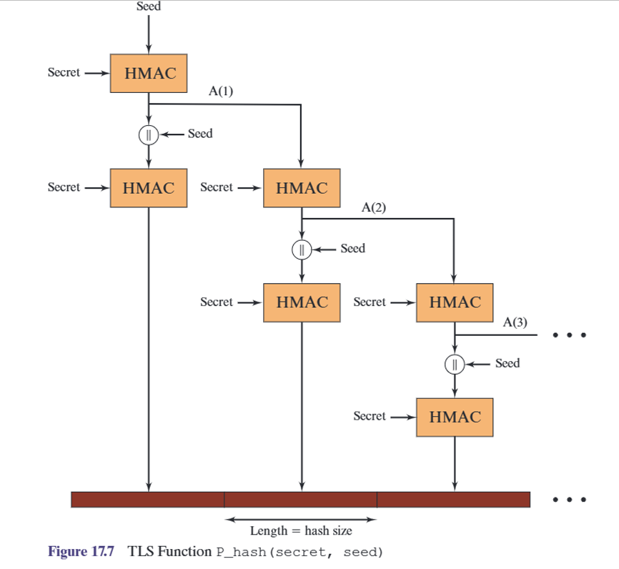

Slide 21
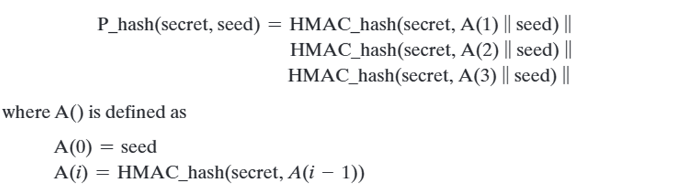

Slide 22
